Slide 1
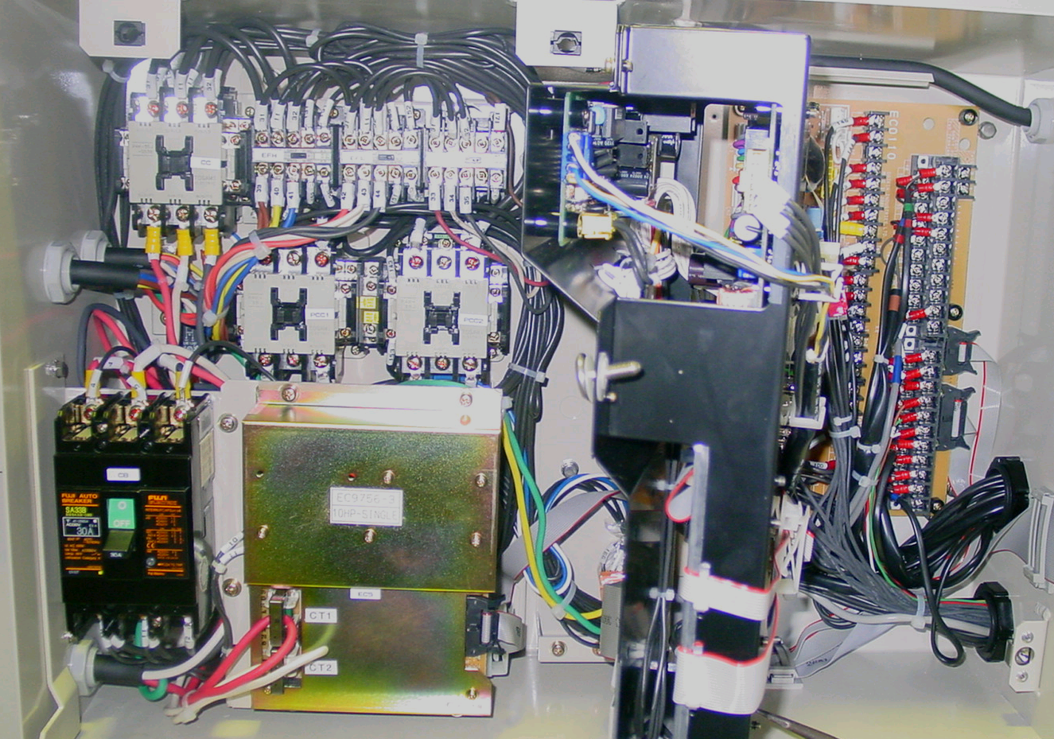
CONTROL BOX
LXE10E-A
CC
EFH
EFL
CFC
RPP
Terminal
Board
TB2
(Output B.)
TB1
(Input B.)
PCC1
PCC2
C/B
PTCT Board CONTROLLER
PTCT Board
MODEM (option)
CONTROLLER
Tr C (400V→24V,13V) under PTCT Board

Slide 2
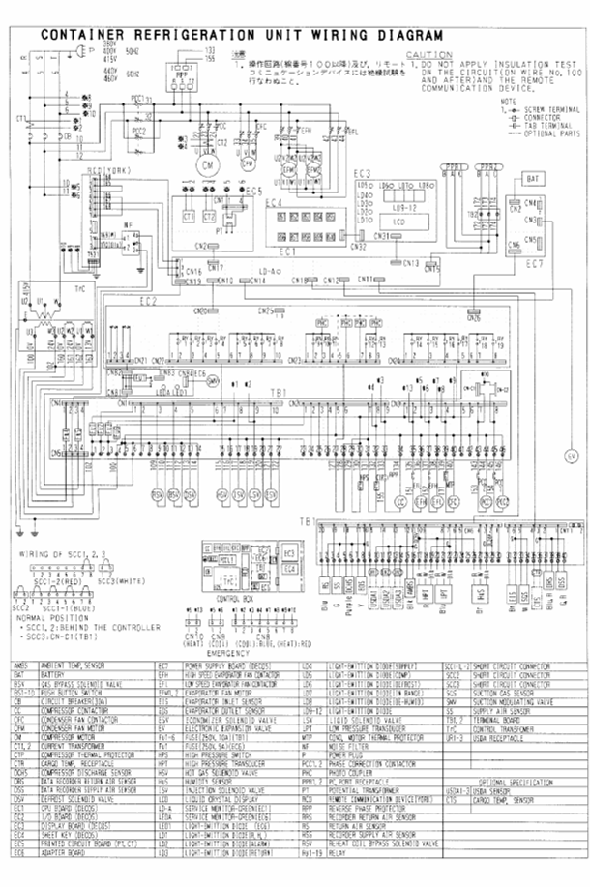
High Voltage
High Voltage
Low Voltage
Low Voltage
This is the wiring diagram of the DAIKIN reefer.
You can separate the diagram in a high voltage part and low voltage part
Next we will show you the power connection lines, when the power plug is connected

Slide 4
Next, we will show you the power connection lines, when the circuit breaker has been switched ON
Power plug 380V 400V 415V 50Hz
440V 460V 60Hz
Circuit Breaker

Slide 5
Circuit breaker ON

Slide 6
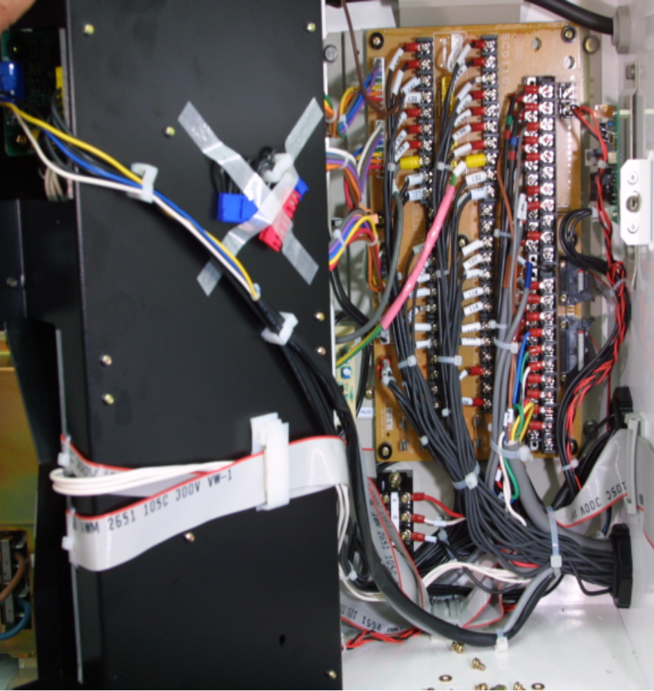
Circuit breaker ON
0 Volts
24 Volts
24 Volts
13 Volts
6 fuses can be found behind the controller on the terminal board (TB1)

Slide 7
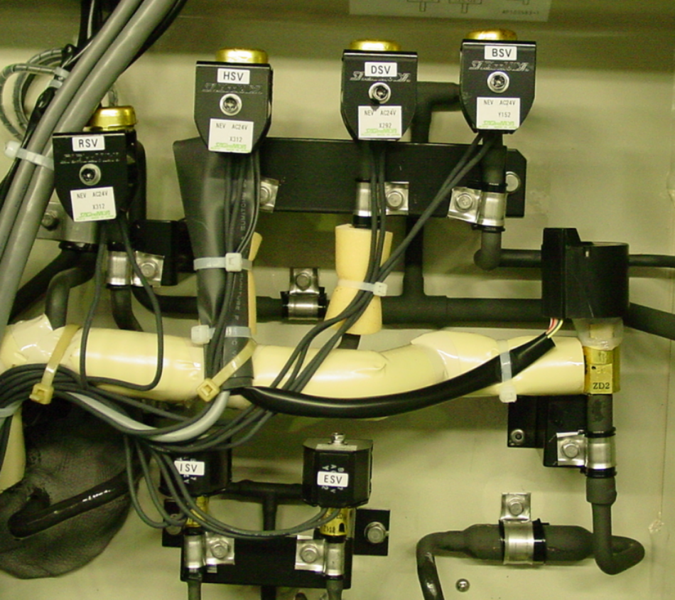
0 Volts
24 Volts
24 Volts
13 Volts
Fuse 1
Fuse 2
Fuse 3
Fuse 4
Fuse 5
Fuse 6
Fuse 7

Slide 8
Chilled Operation
Set point temperature:
+30 degrees C to -2,9 degrees C.

Slide 9
0 Volts
24 Volts
24 Volts
13 Volts
High voltage side of the evaporator high speed contactors will be activated. Motors will start running high speed
High voltage side of the compressor contactor is activated and the scroll compressor starts running
High Voltage side of the condenser fan motor contactor. Contactor activated, CF Motor starts
High Voltage side of the PCC contactor
Low voltage side of the contactor
The RSV valve (Reheat Solenoid Valve) will only be activated when the de-humidification is set and when the temperature is in range
The BSV valve (Bypass Solenoid Valve) will only be activated when the temperature of the oil is too low and when the suction pressure of the compressor is too low
The High Pressure Switch (HPS) and Compressor Terminal Protection (CTP) are checked before the compressor can start
The HSV valve (Hot gas Solenoid Valve) will be activated during capacity control when the SMV valve (Suction Modulation Valve) has been activated, but the inside temperature still goes down. The HSV valve inject hot refrigerant gas into the evaporator and the temperature inside the container will slowly go up.
The ISV valve (Injection Solenoid Valve) will be activated when the compressor discharge temperature becomes too high
The ESV valve (Economizer Solenoid Valve) will be activated when the inside return air temperature is lower then 5 degrees C. This gives extra cooling capacity.
Evaporator motors high speed will start. (chilled cargo means high fan speed)
Condenser Fan Motor starts
Compressor Starts
Suction Modulation valve activated
Suppose that Phase Correction contactor 2 will be activated
The phase contactors PCC1 and PCC2 checks which phase comes into the reefer. If the wrong phase contactor is selected, the motors in the reefer will run the wrong way!

Slide 10
Partly Frozen Operation
Set point temperature:
-3,0 degrees C to -10,0 degrees C.

Slide 11
0 Volts
24 Volts
24 Volts
13 Volts
In Partially Frozen mode, reefer works the same as in Chilled operation. Only the Evaporator motor will change from high speed running to Low speed running.
The Evaporator Low speed contactor will be activated
The Evaporator High speed contactor will be switched OFF

Slide 12
Frozen Operation
Set point temperature:
-10,1 degrees C to -30,0 degrees C.

Slide 13
0 Volts
24 Volts
24 Volts
13 Volts
Switch OFF compressor
Switch OFF condenser Fan
The SMV valve (Suction Modulation Valve) will be 100% open
Condenser Fan switch ON to control the high pressure
Compressor switch ON
During frozen operation, the reefer does not use the RSV and HSV.
When the compressor is switched off, the inside temperature will rise slowly. When the inside temperature is 1 degree C above set point, the compressor and condenser fan will start again, to cool the inside temperature down. Evaporator fan motors keep on running.
When the set point temperature is reached, the compressor and condenser fan will be switched OFF, but the Evaporator fan motors keep on running, to keep the airflow inside of the container

Slide 14
Heating Operation
When the temperature in the container is lower the temperature set point.
(For example, inside temperature -18 C, set point temperature +10 C.)

Slide 15
0 Volts
24 Volts
24 Volts
13 Volts
The condenser fan motor will stop
The Liquid Solenoid valve will switch OFF
Also the other solenoid valves, which were still activated, will be switched OFF
The evaporator fan motors will start running in high speed
To start heating, the DSV (Defrost Solenoid Valve) and HSV (Hot Gas Solenoid Valve) will be activated. Hot refrigerant gas from the compressor will flow directly into the evaporator
First the evaporator motors will switch OFF
When the set point of the reefer has been changed to a high temperature setting, for example +30 degrees C, the reefer will start heating. Now I show you what happens when the temperature has been changed from frozen operation to heating operation
When heating mode is started, the DAIKIN reefer needs to start a “pump down”. This means that all refrigerant will be collected in the receiver and condenser. After that the heating operation will start

Slide 16
Defrost Operation
During cooling operation, ice might cover the evaporator. To remove the ice on the evaporator, defrost is needed

Slide 17
0 Volts
24 Volts
24 Volts
13 Volts
When the defrost is finished, and all ice gas been melted, the reefer will automatically switch over to the cooling mode again.
During the defrost, the evaporator motors are switched OFF.
Defrost is needed to remove the ice from the evaporator. During cooling mode, moisture inside of the container will become frozen on the evaporator. After several hours running of the reefer, this moisture might become one complete ice block around the evaporator. Then there is no air flow of the evaporator fan motors anymore.
To remove the ice, defrost is needed.

Slide 18
QUESTIONS?

